Slide 1
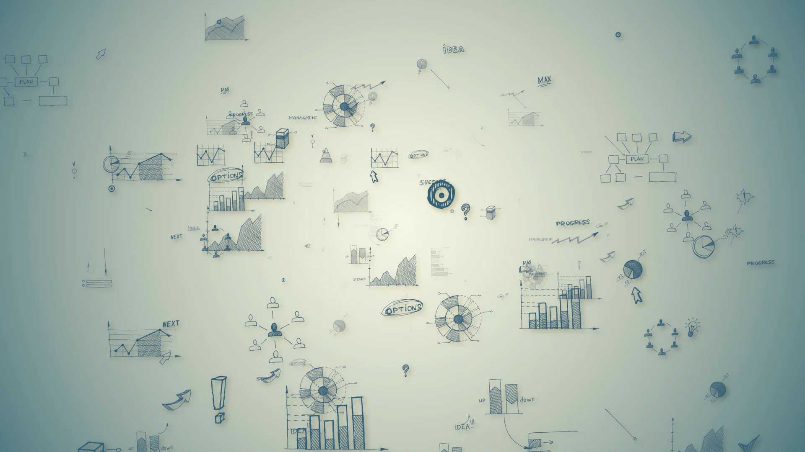
Shiny Conference 2023 Making Project Management Seamless using Automated Gantt Charts in R Shiny
Lucy Njoki Njuki
Dr Yuanyuan Zhang

Slide 2
Overview
Background
The development of our R Shiny app
Showcase of the Shiny app
Resources and References

Slide 3

Background
We frequently engage in multiple projects and maintaining an organised record of project tasks can be difficult if not adequately documented.
Gantt charts are often recommend for project management.
However, the cost of project management tools can be high (sources).

Slide 4

Background
We opted to utilise R not only for our daily tasks but also because it is an open-source platform that offers on great deal of packages for creating Gantt charts.
Initial idea was to use R Markdown to display the Gantt charts and underlying data, which can be shared as an HTML file.
However, updating the charts requires re-running the R Markdown script which can be inconvenient.

Slide 5
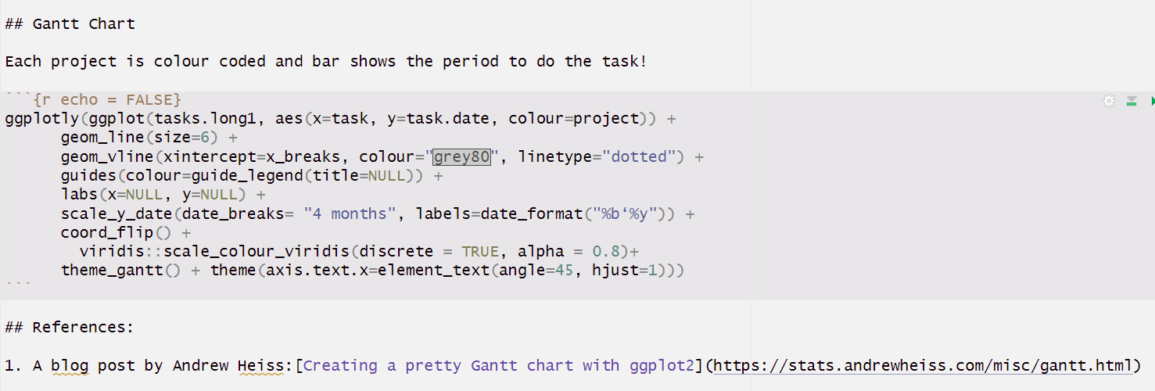
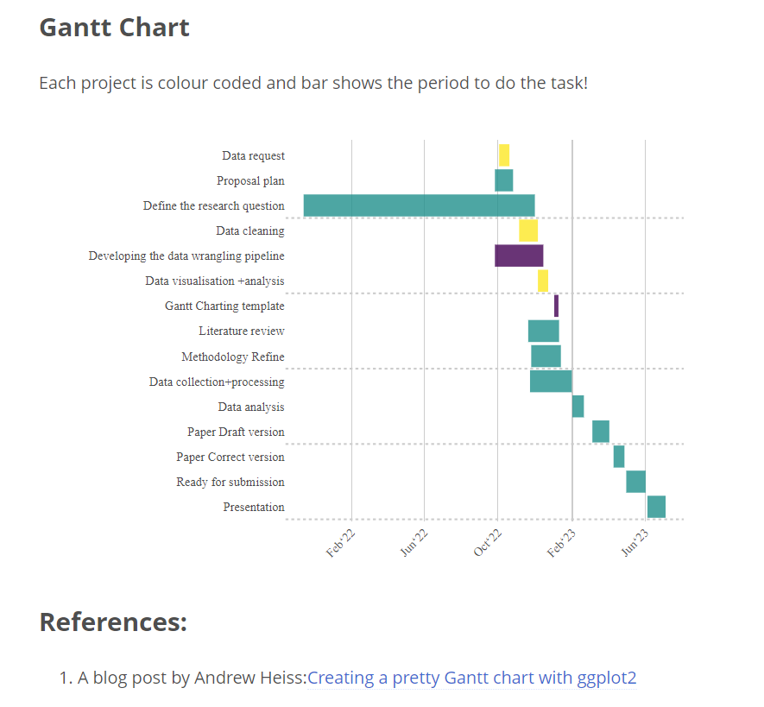
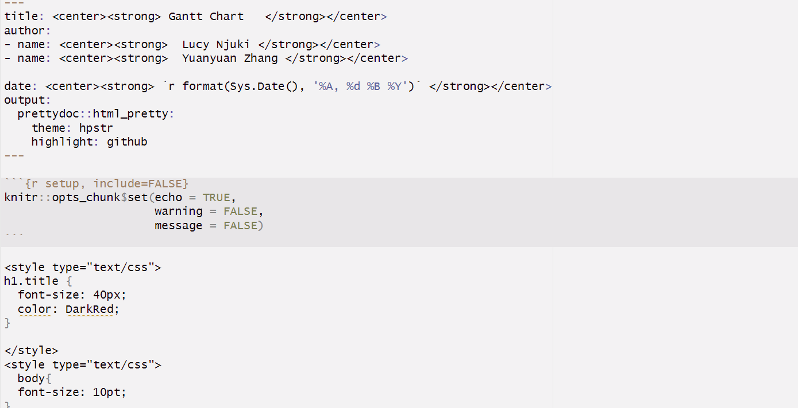
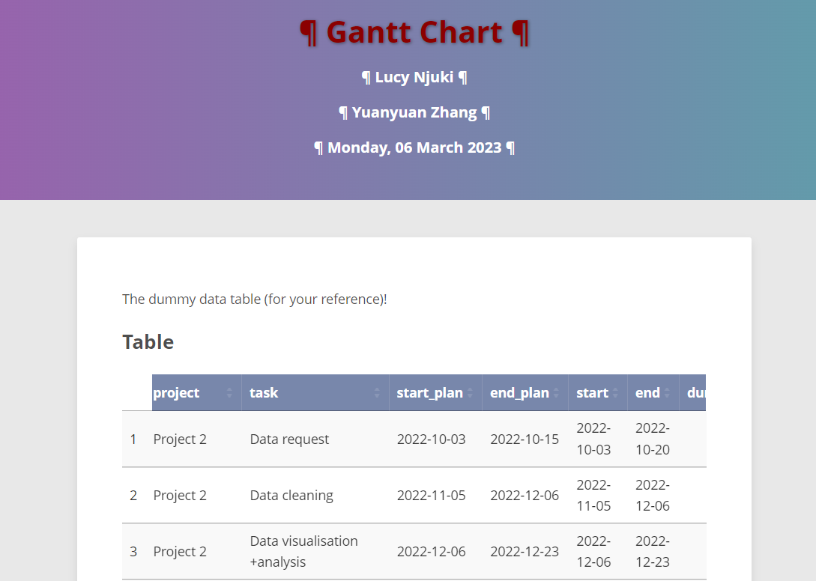

Slide 6

And here comes R Shiny to the rescue
We developed an R Shiny app that automates the task-tracking process and offers interactive functionality across several pages, including:
Homepage: presents overview of the project tasks
Gantt chart: utilises {ggplot2}, {plotly} and {vistime} R packages to generate Gantt charts
Create your own: enables users to generate their own Gantt charts using the three packages
Progress report: plot showing the discrepancy between the actual and estimated task completion dates
The shiny app, we created can be found here: Making Project Management Seamless

Slide 7
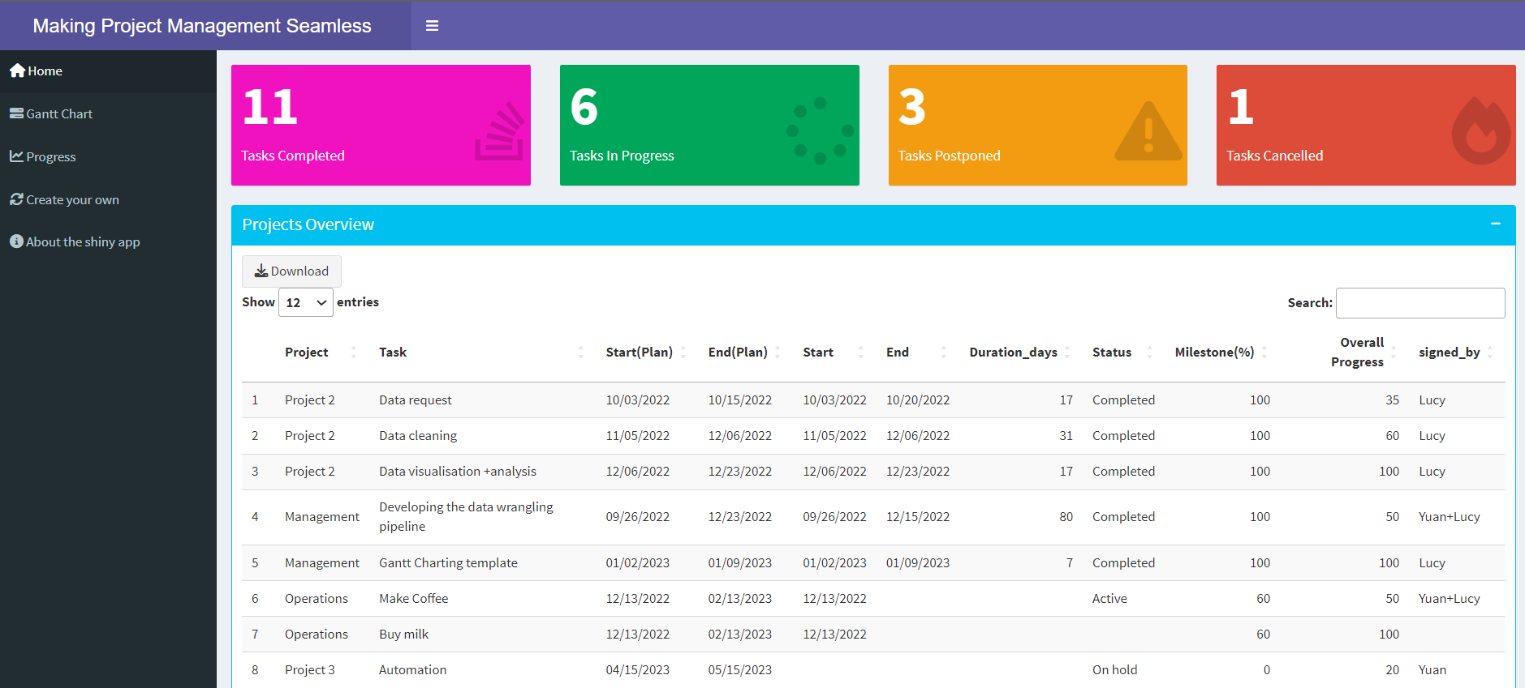
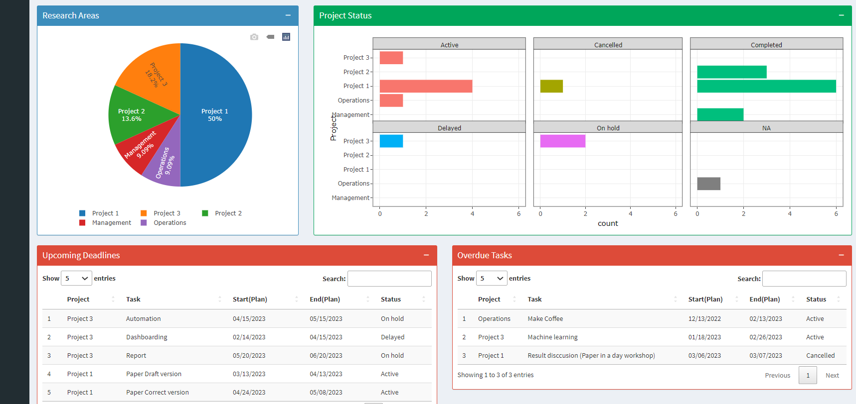
Shiny App: Homepage
The homepage has the following features:
Project overview
Research areas
Status of the project such as delayed
Upcoming deadlines
Overdue tasks

Slide 8
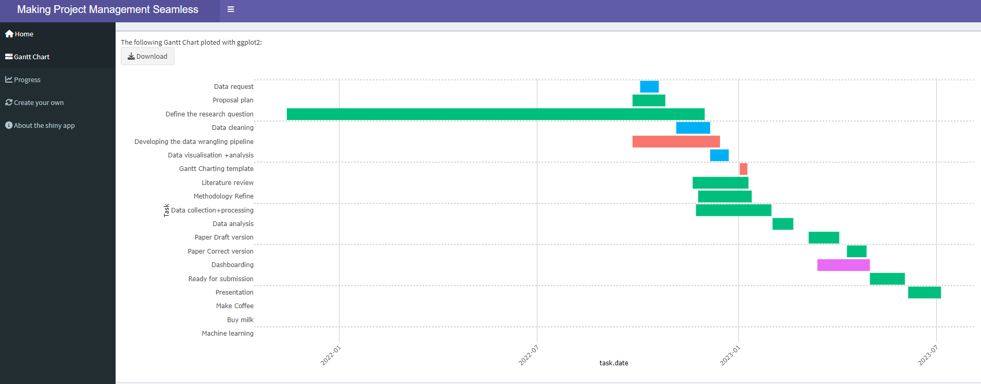
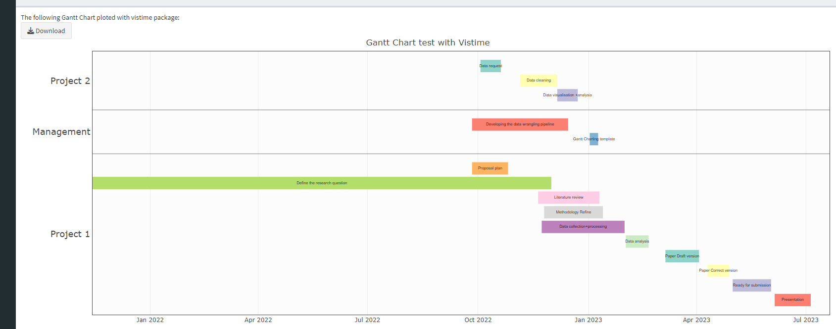
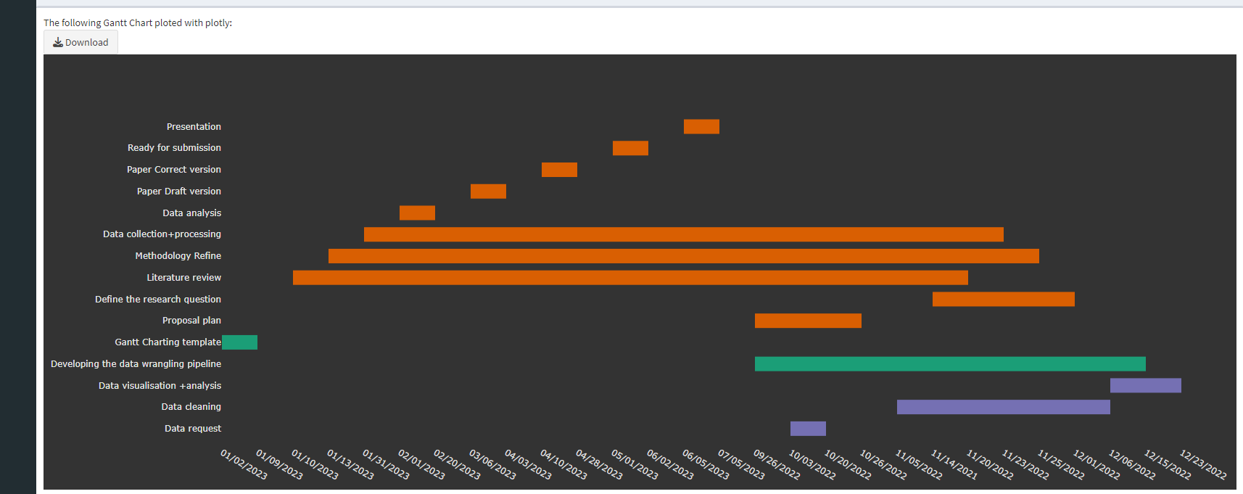
Shiny App: Gantt Chart
ggplot2 Gantt chart:
The dataset needs to be transformed to a long format.
While it is possible to colour-code the projects, grouping together is not supported by default.
plotly Gantt chart:
Using plotly allows for grouping projects together, but only if they are inputted together in the data file.
vistime Gantt chart:
By default, the projects are grouped together.
However, label size must be reduced to avoid cluttering.

Slide 9
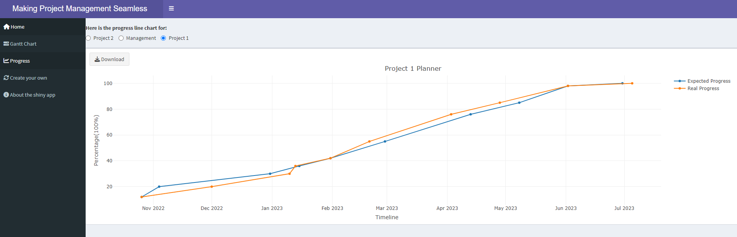
Shiny App: Progress Report
It is crucial to keep track of how much progress has been made on a task relative to its estimated completion time.
To accomplish this, we use a progress report graph.

Slide 10
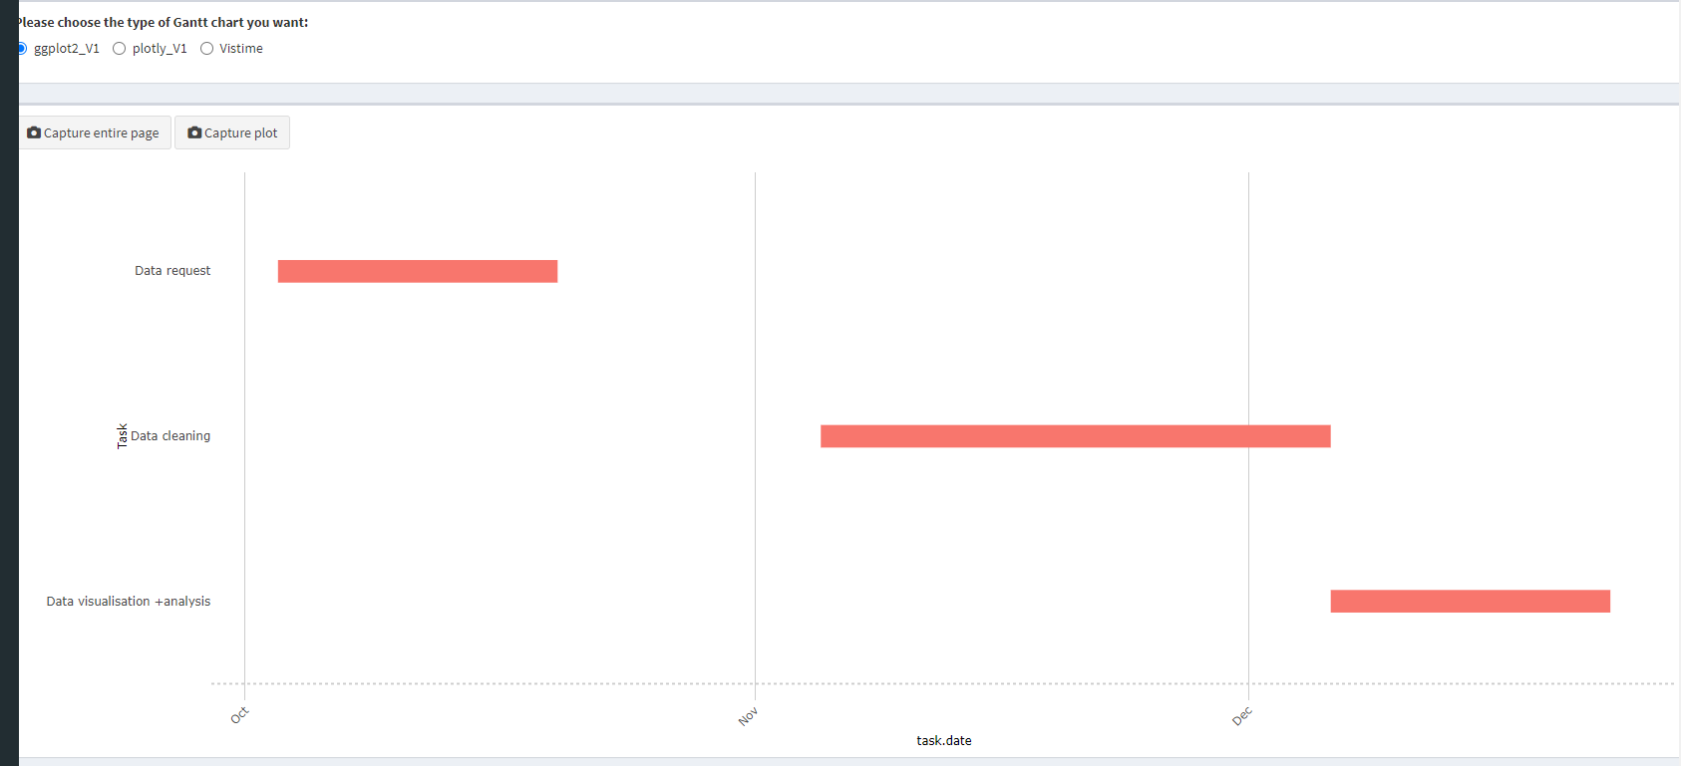
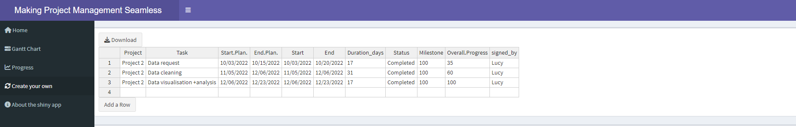
Shiny App: Create your own
A data table with column names is presented to the user, who then inputs data into the columns provided.
Upon completion of data entry, a Gantt chart is generated and displayed automatically.
Moreover, the user has the options to select a chart of their preference.

Slide 11
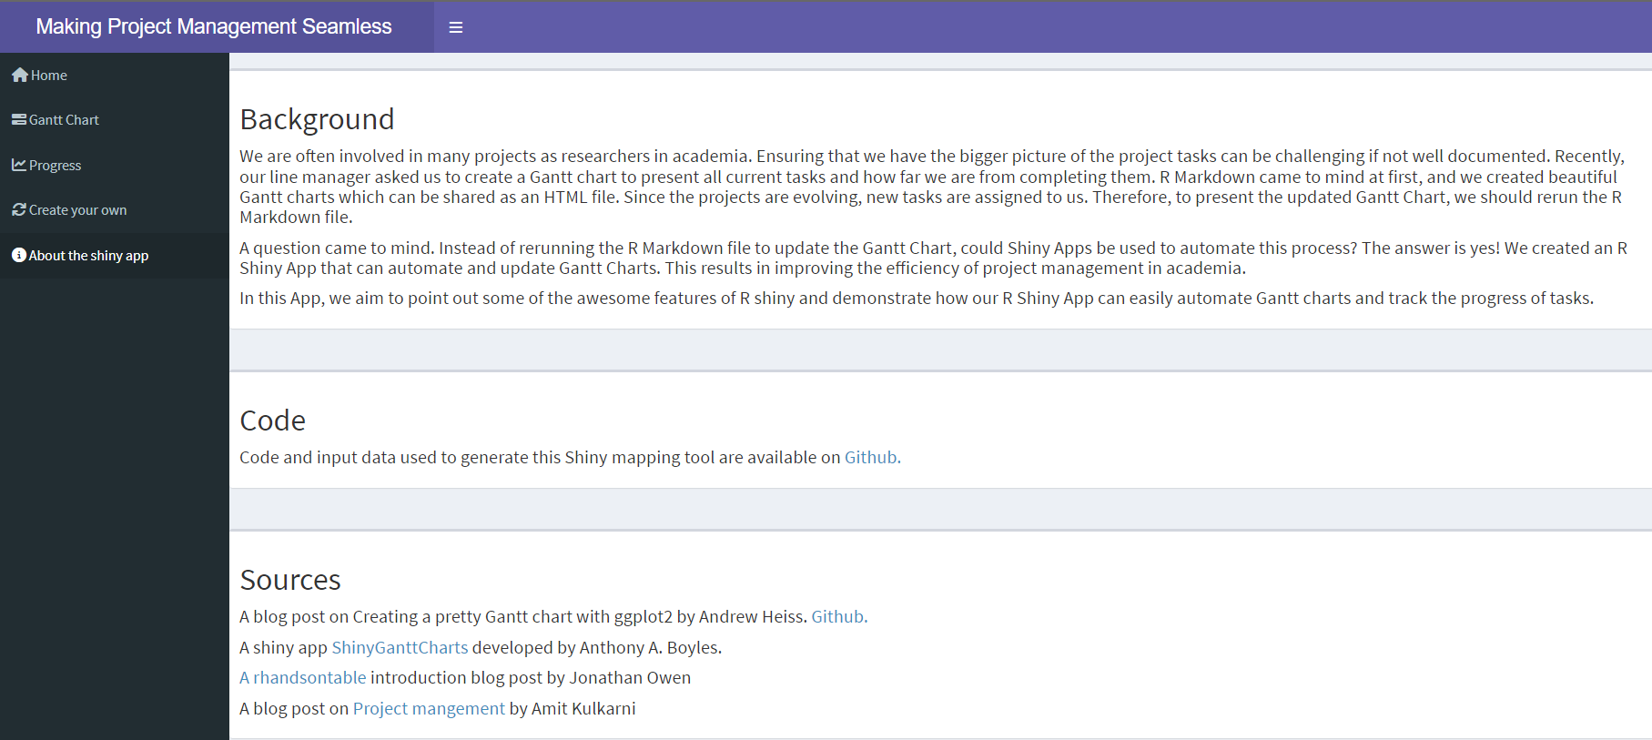

Shiny App: About the shiny app

Slide 12
R Packages we used
We utilised the following R packages:
For the Shiny App:
shiny, shinydashboard and shinywidgets
For data manipulation:
data.table, lubridate, rhandsontable, dplyr, tidyr and DT
For creating plots:
ggplot2, plotly, vistime, scales, RColorBrewer and bslib
Additional features:
shinyscreenshot

Slide 13
Some interesting features about our app
The shiny app allows the user to bookmark it, and the link will take them to the last value displayed.
We demonstrated the use of three packages for creating Gantt charts, and users can choose which one they prefer.
To add on, the shiny app allows users to take screenshots of the entire page or a graph.
Additionally, we utilised packages such as rhandsontable to create a data table that can serve as a data collection tool and updates the Gantt chart automatically.

Slide 14
Have we sparked your interest in creating a Gantt chart?
Starting point:
A blog post on Creating a pretty Gantt chart with ggplot2 by Andrew Heiss.
ShinyGanttCharts shiny app developed by Anthony A. Boyles.
rhandsontable introduction blog post by Jonathan Owen.
Other features such as bookmarking an R shiny app can be found in resources as https://mastering-shiny.org/action-bookmark.html.
Link to the GitHub repository containing the R script can be found here: Shiny-Confy-2023

Slide 15
References
A blog post by Andrew Heiss: Creating a pretty Gantt chart with ggplot2
ShinyGanttCharts shiny app created by Anthony A. Boyles
Mastering Shiny book by Dr Hadley Wickham
A blog post by Amit Kulkarni: Manage your Projects & Tasks with R Shiny

Slide 16
Acknowledge
Colleagues and friends who greatly helped with the testing of the app.

Slide 17

Thank you!!

